Slide 1

Behavior-Driven Design and User Stories
Chapter 7
© 2013 David Patterson & David Patterson
Licensed under Creative Commons Attribution-NonCommercial-ShareAlike 3.0 Unported License

Slide 2

Introduction to Behavior-Driven Design and User Stories
Engineering Software as a Service §7.1

Slide 3
Why do SW Projects Fail?
Don't do what customers want
Projects are late
Over budget
Hard to maintain and evolve
Or all of the above
How does Agile try to avoid failure?

Slide 4
Agile Lifecycle Review
Work closely, continuously with stakeholders to develop requirements, tests
Maintain working prototype while deploying new features every iteration
Check with stakeholders on what's next, to validate building right thing

Slide 5
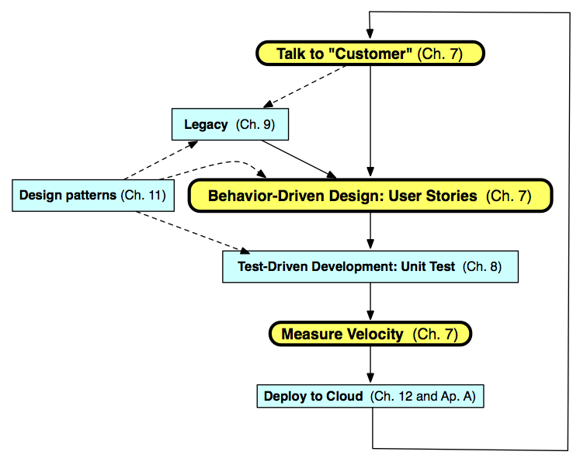
Agile Iteration

Slide 6
Behavior-Driven Design (BDD)
BDD asks questions about behavior of app before and during development to reduce miscommunication
Requirements written down as user stories
BDD concentrates on behavior of app vs. implementation of app

Slide 7
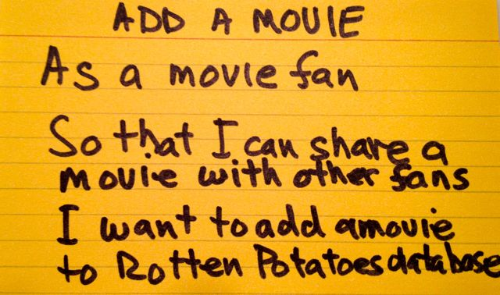
User Stories
1-3 sentences in everyday language
“Connextra” format:
Feature name
As a [kind of stakeholder], So that [I can achieve some goal] I want to [do some task]
3 phrases must be there, can be in any order
Idea: user story can be formulated as acceptance test before code is written
Notes:
Dave Patterson created this image
From HCI community

Slide 8
Different stakeholders may describe behavior differently
See which of my friends are going to a show
As a theatergoer
So that I can enjoy the show with my friends
I want to see which of my Facebook friends are attending a given show
Show patron’s Facebook friends
As a box office manager
So that I can induce a patron to buy a ticket
I want to show her which of her Facebook friends are going to a given show

Slide 9
Which of the following is false?
BDD is designed to help with validation (build the right thing) in addition to verification
User stories should include information about implementation choices
User stories in BDD play same role as design requirements in plan-and-document
The same app functionality could be featured in multiple user stories from different stakeholders’ perspectives
Notes:
B is false

Slide 10

Points, Velocity, and Pivotal Tracker
Engineering Software as a Service §7.2

Slide 11
Productivity and Tools
Don't we want to avoid major planning effort in Agile?
Can User Stories be used to measure progress on project?
What should a tool do to help measured progress for Agile?

Slide 12
Measuring Productivity
A measure of team productivity: calculate average number of stories / week?
Rate each user story in advance on a simple integer scale
1 for straightforward stories
2 for medium stories
3 for very complex stories
Velocity: average number of points / week

Slide 13
Product Backlog
Real systems have 100s of user stories
Backlog: user stories not yet completed
Prioritize so most valuable items highest
Organize so they match SW releases over time

Slide 14
Team Cyberspace Whiteboard
Teams need a place to share information
Examples:
Tracker allows attaching documents to User stories (e.g., LoFi UI)
Wiki with Github repository
Google Documents: joint creation and viewing of drawings, presentations, spreadsheets, and text documents
Campfire: web-based service for password-protected online chat rooms

Slide 15
Which is true?
When comparing two teams, the one with the higher velocity is more productive
When you don’t know how to approach a given user story, just give it 3 points
The backlog consists of completed user stories
Velocity is the average number of points per week
When comparing two teams, the one with the higher velocity is more productive
Notes:
D is true

Slide 16
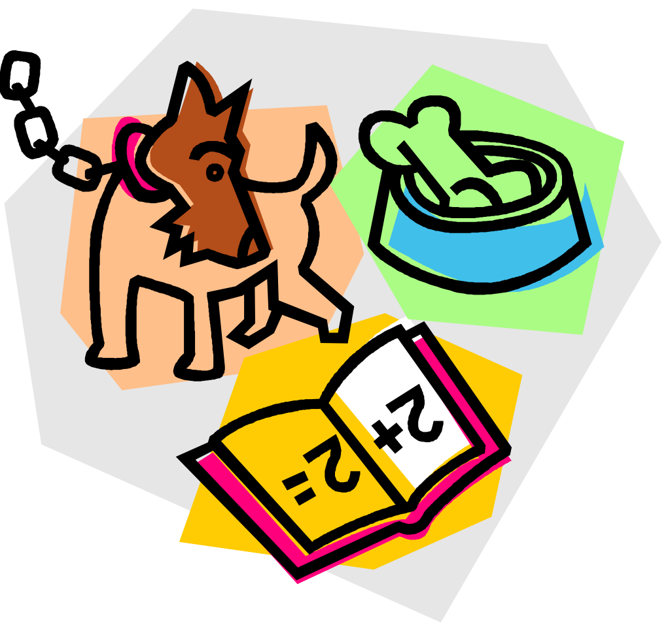
SMART User Stories
Engineering Software as a Service §7.3

Slide 17
Creating User Stories
How do you know if you have a good user story vs. bad user story?
Right size?
Not too hard?
Is worthwhile?

Slide 18
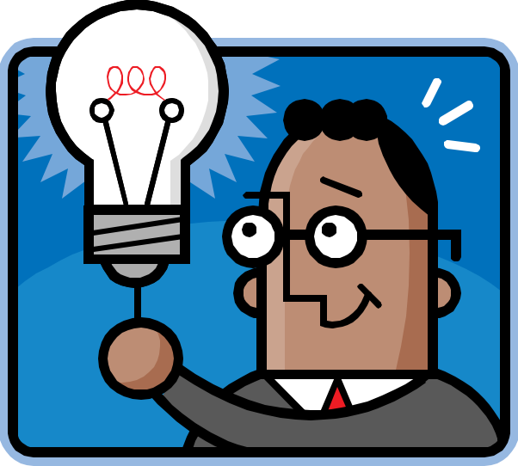
SMART stories
Specific
Measurable
Achievable
Relevant
Timeboxed

Slide 19

Specific & Measurable
Each scenario testable
Implies known good input and expected results exist
Anti-example: “UI should be user-friendly”
Example: Given/When/Then.
Given some specific starting condition(s),
When I take specific action X,
Then one or more specific thing(s) should happen

Slide 20
Achievable
Complete in 1 iteration
If can’t deliver feature in 1 iteration, deliver subset of stories
If <1 story per iteration, need to improve point estimation per story

Slide 21
Relevant
Discover business value, or kill the story:
Protect revenue
Increase revenue
Manage cost
Increase brand value
Making the product remarkable
Can you include stories that don’t have obvious business value?

Slide 22
Features
Feature == collection of related stories that describe set of behaviors
Example: “See which of my friends are going to show” is a feature
story 1: none of my friends are going
story 2: a couple of my friends are going
story 3: all my friends are going—more thumbnail photos than will fit on page
etc.
Stories are SMART but features should be relevant

Slide 23
Which feature below is LEAST SMART?
User can search for a movie by title
Given I have a free movie pass, I want to redeem it for an eligible movie before it expires
When adding a movie, 99% of Add Movie pages should appear within 3 seconds
As a customer, I want to see the top 10 movies sold, listed by price, so that I can buy the cheapest ones first
Notes:
2nd is least smart. Smarter: "Given I have a movie pass that expires 12/31/15, and the following movies are eligible for it...with expiration dates..."

Slide 24
Lo-Fi UI Sketches and Storyboards
Engineering Software as a Service §7.4

Slide 25
Building Successful UI
SaaS apps often faces users
User stories need user interface (UI)
How get customer to participate in UI design so they are happy when it’s complete?
Avoid What-I-Said-But-Not-What-I-Want UI?
UI version of 3x5 cards?
How show interactivity without building prototype?

Slide 26
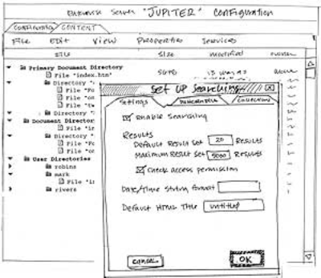
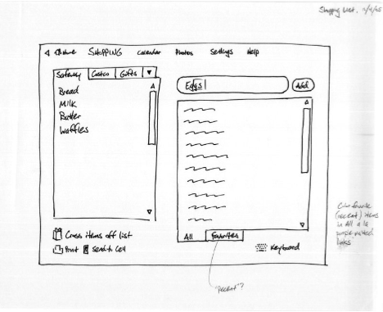
Lo-Fi UI Sketches

Slide 27
User Stories => Sketches
Match user-stories to sketches
Think about all user interactions
Pages or sections of pages
Forms, buttons
Popups/lightboxes
Milestone 1: User stories, lo-fi sketches, storyboards, and architecture diagrams

Slide 28
Example: Facebook
When I log in, I want to be able to:
See top news from my friends
See friends that are online
See upcoming events
See today’s birthdays
Search for a friend’s profile
Change my own profile settings
Share a status, link, image, etc.

Slide 29
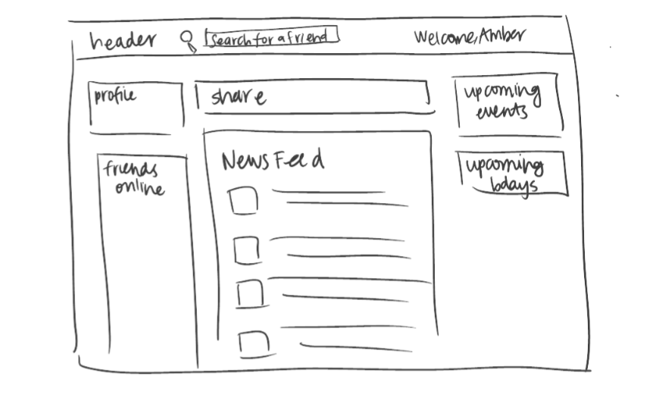
Example: Facebook

Slide 30
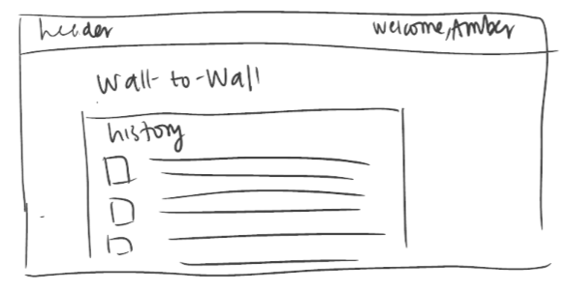
Example: Facebook
I want to be able to:
view a friend’s entire wall conversation with me (or another friend)

Slide 31
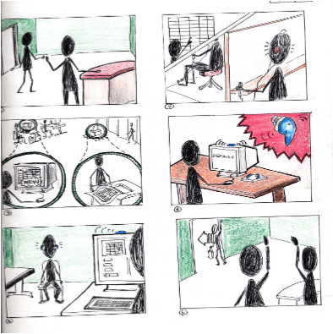
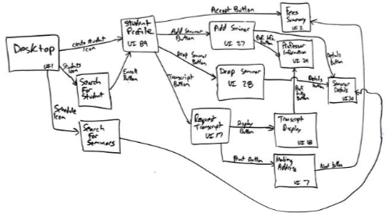
Storyboarding

Slide 32
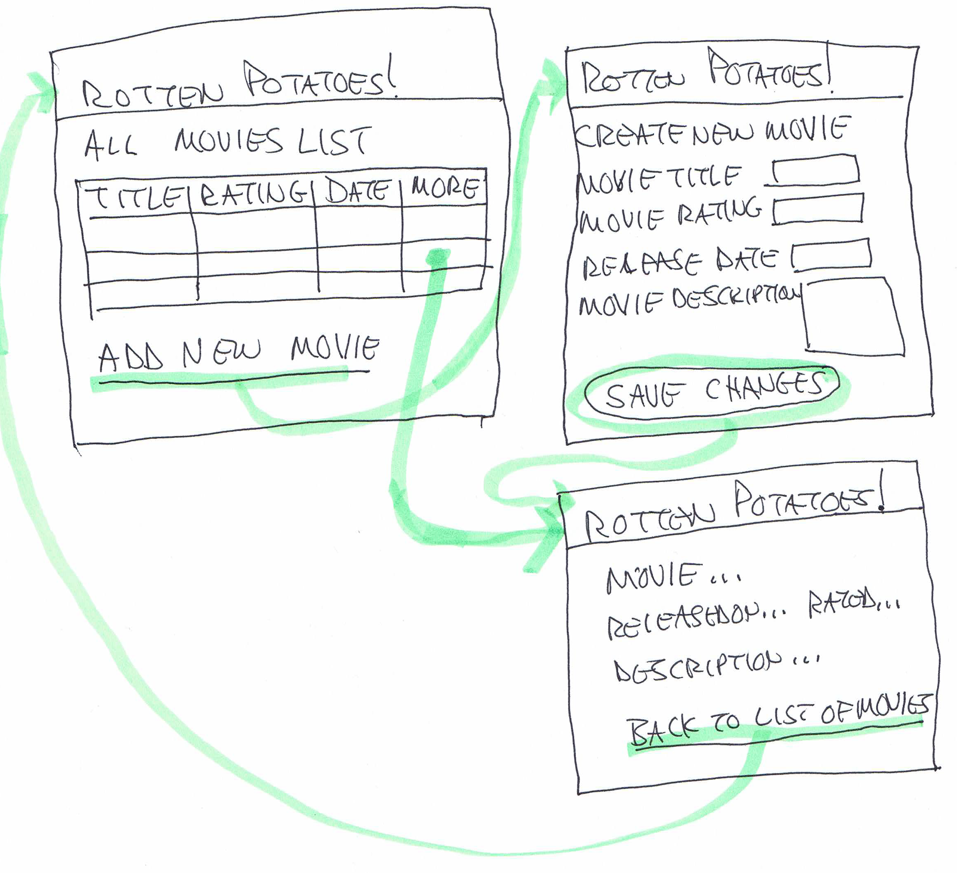
Example Storyboard
(Figure 4.4, Engineering Long Lasting Software by Armando Fox and David Patterson, Alpha edition, 2012.)

Slide 33
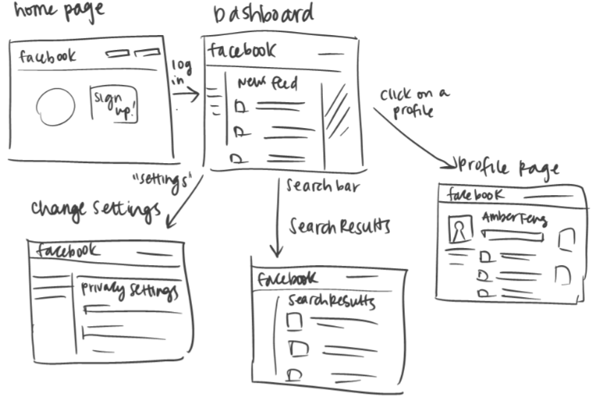
Ex. Facebook

Slide 34
Which is FALSE about Lo-Fi UI?
Sketches and storyboards (vs. code) are more likely to involve all stakeholders
The purpose of the Lo-Fi UI approach is to debug the UI before you program it
SaaS apps usually have a user interface associated with the user stories
While lo-fi storyboarding takes longer than prototyping the UI in CSS/HTML, the lo-fi approach is more likely to lead to a UI that customers like
Notes:
D is False; takes less time than coding

Slide 35
Which statement is FALSE about Lo-FI UI and BDD?
The purpose of the Lo-Fi UI approach is to debug the UI before you program it
A BDD downside is requiring continuous contact with customers, which may not be possible
A BDD downside is that it may lead to a poor software architecture, since focus is on behavior
None are false; all three above are true
Notes:
4th one; all true

Slide 36
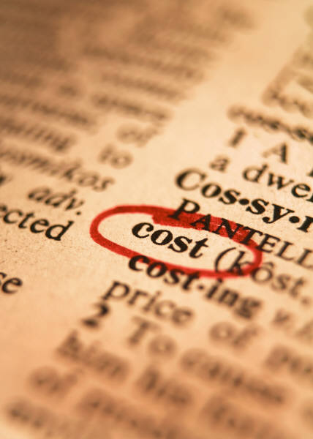
Agile Cost Estimation
Engineering Software as a Service §7.5

Slide 37
Agile Cost Estimation
Real world needs to estimate cost before customer can agree to project
If no careful planning and schedule in Agile, how can you estimate the cost of a project?

Slide 38
Pivotal Labs Model
Pivotal Labs teaches customer Agile
Using Agile, Pivotal never commits to delivering features X, Y, and Z by date D
Instead, commits resources to work in the most efficient way possible up to date D
Customer works with team to define priorities continuously up to date D
Still need estimate for project

